Slide 1
7,043
Customer Churn
Customers Analyzed
Prediction
26.5%
for Telecom Companies
Overall Churn Rate
Capstone Project — Predictive Analytics
5
IBM Telco Customer Churn Dataset | Kaggle
ML Models Trained
Team Members
Abhitha Raj S R
Ananthanarayanan B
Lanka Priya

Slide 2
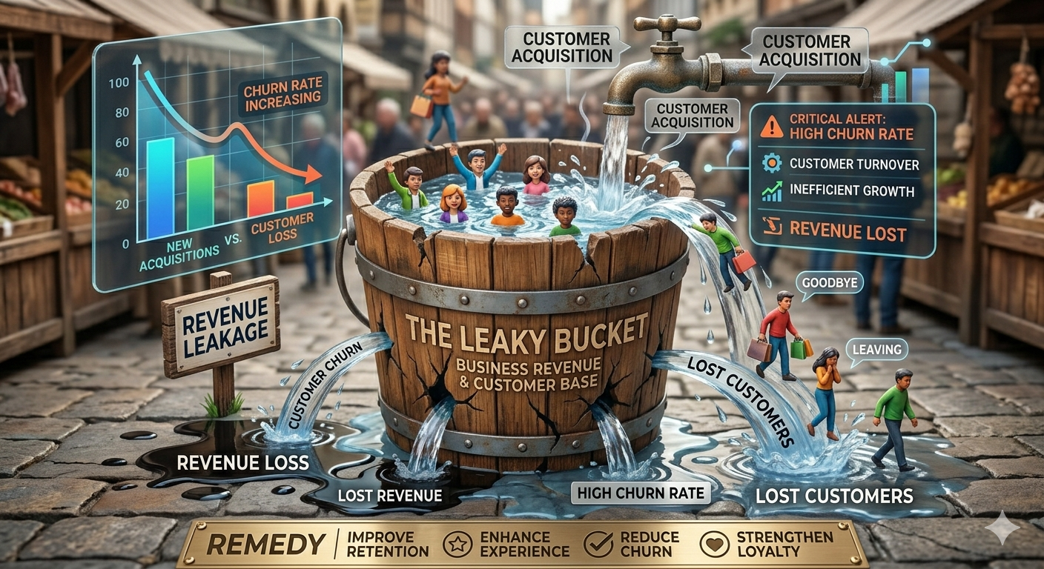
Problem Statement
The Multi-Billion Dollar Problem
Churn is the single largest threat to telecom profitability.
Getting a new customer costs 5-25x more than keeping an existing one.
High competition makes it easier for customers to switch providers.

Slide 3





Project Overview
01
02
03
04
05
Data Loading
Preprocessing
EDA
Modeling
Insights
IBM Telco dataset
7,043 rows × 21 features
Clean, encode & scale
SMOTE for class balance
Visualize churn patterns
across all features
5 ML models trained
& compared
Feature importance
& recommendations
Dataset: IBM Telco Customer Churn (Kaggle) | Target: Predict customer churn

Slide 4
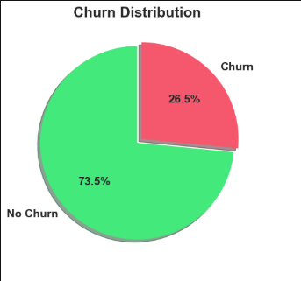
Exploratory Data Analysis — Key Findings
HIGH CHURN SEGMENTS
LOW CHURN SEGMENTS
26.5%
Month-to-month contracts: 42.7%
Fiber optic internet: 41.9%
Electronic check payments: 45.3%
No tech support: ~42%
Senior citizens: 41.7%
New customers (< 12 months)
Two-year contracts: ~3%
DSL internet: ~19%
With add-on services (security/backup)
Long-tenure (48+ months)
Overall Churn Rate
2.73:1
Class Imbalance Ratio

Slide 5
Feature Engineering & Preprocessing
TenureGroup
AvgMonthlyCharge
NumServices
Binned: 0–12, 13–24, 25–48,
49–60, 61–72 months
TotalCharges ÷ tenure
Captures spending trend per month
Count of active services
(Phone, Internet, Security, etc.)
TotalCharges Fix
SMOTE Oversampling
One-Hot Encoding
Blank strings → NaN
Imputed with tenure × MonthlyCharges
Balanced training set
No Churn: Yes = 1:1 ratio
Categorical → numeric
StandardScaler on numerics

Slide 6
Model Training & Strategy
Logistic Regression
Random Forest
SVM
XGBoost
LightGBM
Baseline linear model
fast & interpretable
Random Forest builds 200 decision trees independently and combines their votes.
SVM finds the optimal boundary that separates churners from non-churners.
XGBoost builds trees sequentially — each new tree corrects the mistakes of the previous one.
LightGBM does the same thing as XGBoost but grows trees leaf-wise instead of level-wise, making it significantly faster.
Training Pipeline
Raw Data
→
Clean &
Encode
→
SMOTE
80% Train
→
Fit Model
→
Evaluate
Test 20%
Stratified 80/20 train-test split | SMOTE applied only on training data | Metrics: Accuracy, Precision, Recall, F1, ROC-AUC

Slide 7
Model Performance Comparison
Model | Accuracy | Precision | Recall | F1-Score | ROC-AUC
Logistic Regression | 73% | 0.60 | 0.76 | 0.617 | 0.84
Random Forest | 77% | 0.62 | 0.71 | 0.619 | 0.84
SVM | 76% | 0.62 | 0.69 | 0.622 | 0.82
XGBoost | 78% | 0.60 | 0.73 | 0.576 | 0.83
LightGBM | 78% | 0.60 | 0.70 | 0.585 | 0.83

Slide 8
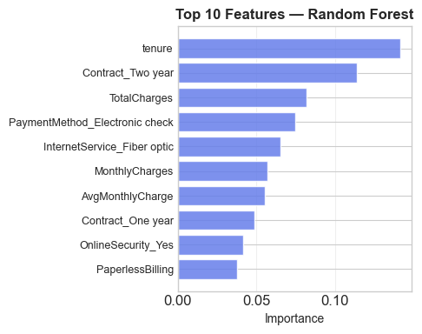
Feature Importance & Top Churn Drivers
Random Forest — Top 10 Features
Key Takeaways
Contract_Two-year
📋 Contract type is the #2 predictor of churn
tenure
Contract_One-year
9.2%
⏱️ Tenure strongly inversely correlated with churn
TotalCharges
8.8%
MonthlyCharges
7.6%
📡 Fiber optic users at high risk — quality issues?
AvgMonthlyCharge
6.5%
NumServices
5.4%
🔒 Security & Tech Support reduce churn significantly
InternetService_Fiber
4.7%
OnlineSecurity_Yes
3.9%
💰 High monthly charges correlate with churn
TechSupport_Yes
3.3%

Slide 9
Deployment & Live Application
The model is deployed as a Streamlit web application
Framework
Best Model
Input
Output
Streamlit
Random Forest
Customer Profile
Churn Probability
Interactive web UI
77% accuracy, AUC 0.84
21 input features
Risk score + segment
How It Works
Enter Customer Details
→
Preprocess & Encode
→
Model Predicts
→
Show Churn Risk %
→
Actionable Advice
$ streamlit run app.py

Slide 10
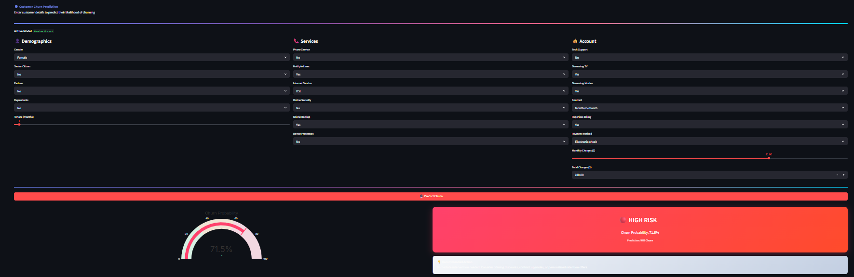
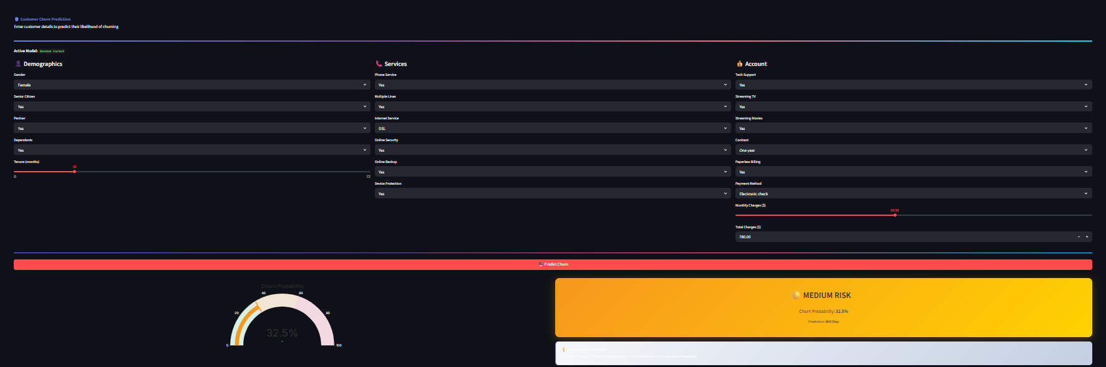
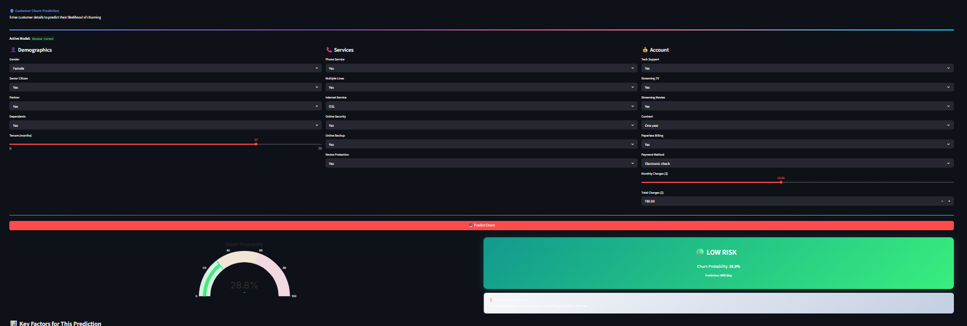

Slide 11
Summary
Key Takeaways
01
Churn Rate: 26.5%
Class imbalance handled with SMOTE oversampling for better model recall
02
Best Performers: Random Forest
77% accuracy, F1 Score of 0.62 on held-out test data
03
Top Churn Drivers
Contract type, tenure, internet service type, and add-on services
04
Deployed on Streamlit
Live app predicts churn probability for any customer profile
Customer Churn Prediction — Telecom | Capstone Project — Predictive Analytics

Slide 12
Thank You...

